Slide 1
Getting you data ready
Royal Mail International

Slide 2
Overview
More and more countries are starting to require that all parcels they receive from the UK and around the world must have electronic pre-advice data sent to them in advance. This includes information on the sender, the recipient and the contents of the parcel.
Royal Mail increasingly needs to provide this electronic data to receiving countries on your behalf. which are rapidly coming into focus.
We need you to prepare to send this data in the correct format to meet these new requirements so that you can provide electronic data when it becomes necessary and continue to post overseas as you do now.
Through sharing electronic data, countries should also be able to speed up customs clearance and import processes leading to faster delivery times
Also we want to ensure that you are in a position to take advantage of additional tracking and future enhanced export features enabled by the provision of recipient contact details.

Slide 3
Landscape and legislation
Background
You must provide pre-advice when posting parcels overseas. This pre-advice includes ‘customs information’. Providing more detailed and electronic pre-advice data can enable an easier customs clearance process abroad.
Security is high on the agenda (USA)
Automate manual processes
Legislation
EU 2020 – The Union Customs Code Regulation
Others to follow
Risks
Refusal (USA), charges (Brazil) and potential delays (China and Russia)
Supporting customers
We want to put you on the front foot ensure that you are ready to provide data when it becomes necessary

Slide 4
Electronic data requirement
What data do we need?
What this means for you?
The fields below are the same information as is already required. These must be filled in accurately and electronically. The green and blue boxes are mandatory information.
DMO has been updated to enable collection of this data
*Please note: If you post overseas using DMO, you will either need to migrate to Click & Drop or if this is not possible, then you must contact the DMO helpdesk to turn on customs documentation
Click & Drop will be updated in good time for the deadline of 01 April 2018
Specifications for COSS and SAPI will be updated to include the new requirement
Specifications have been provided to 3rd party shipping platforms
Sender details (Name, address)
Basic info
Recipient details (Name, address including destination country)
Sender telephone number and email
Item details (Description, quantity, weight and value of contents)
Customs
info
What else is required?
Trade Tariff (Harmonised System or HS) code and country of origin of contents
A Universal Postal Union (UPU) S10 barcode is also required on export parcels (including untracked) so that each item can be linked via the barcode to the electronic pre-advice information
Updated Royal Mail Shipping Solutions will create this barcode automatically and new specifications for 3rd parties will also include the barcode specification
Postage and insurance costs
Future product features
Recipient mobile number and email
Notes:
Using RM shipping solution
DMO average was never acceptable, now we can spot it, or squiggles. We now require customers to supply this information electronically
*We must offer option of migration to Click & Drop as first solution. It is much more user friendly for customers than having to contact DMO helpdesk to turn on customs docs. Click & Drop will fulfil all the requirements and help customers automate their shipping process. They can fill in electronically all the required details and it will provide 4 labels – one with barcode, one pick & pack, one electronic customs doc, one shipping label.
Specifications for COSS & SAPI do not currently include recipient email – we are working on a solution for that.

Slide 5
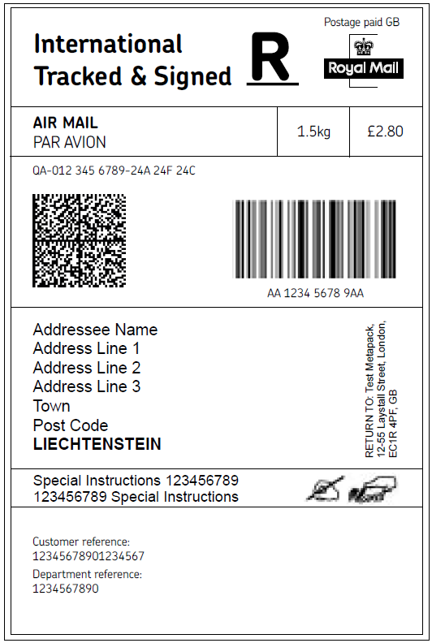
Labels and electronic data
Parcel details
Product / Service Type
Unique ID
Format / Dimensions
Parcel details
Weight
Postage cost
UPU S10 Barcode inc. untracked
Recipient Details
Contact name
Business name
Street address line 1
Street address line 2
Street address line 3
City
County
Postcode
Country
Mobile number
Email address
Sender Details
Contact name
Business name
Street address line 1
Street address line 2
Street address line 3
City
County
Postcode
Country
Telephone number (mobile preferred)
Email address
- Basic information
- For Future product enhancements
- Customs information

Slide 6
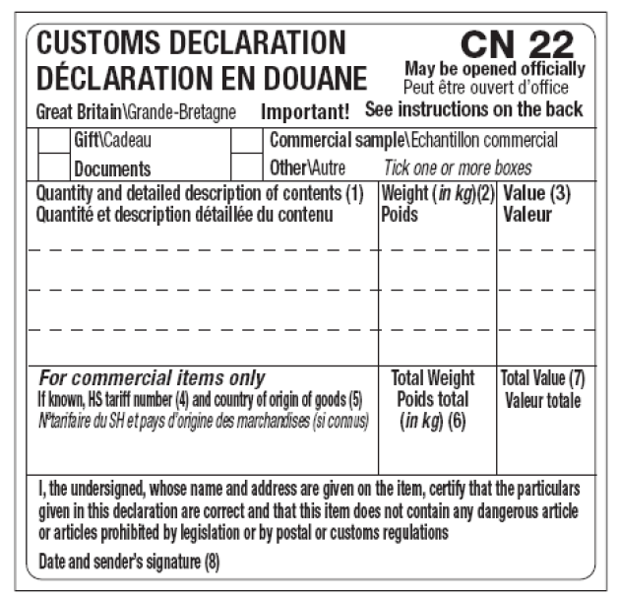
CN22
Per Parcel
Category (e.g. gift/documents etc.)
Value
Sender’s signature (to certify declaration)
Date
Per Contents Item
Description
Quantity
Weight
Value
Per Parcel
Trade tariff (Harmonised System or HS) code
Country of origin of goods
All of this data needs to be submitted electronically in the pre-advice. Royal Mail Shipping Systems can enable label production to make the process even easier. Please note: The sender can add their signature electronically.
There is an Harmonised System (HS) lookup function in DMO. Customers using other systems should follow this HMRC link for more information.
- Basic information
- For Future product enhancements
- Customs information
Notes:
Automating label printing

Slide 7
Continued..CN23
Per Parcel
Category (e.g. gift/documents etc.)
Value
Sender’s signature (to certify declaration)
Date
Per Parcel
Trade tariff (Harmonised System or HS) code
Country of origin of goods
Per Contents Item
Description
Quantity
Weight
Value
- Basic information
CN22’s and CN23’s should already be populated fully and accurately. The change for some customers will be to provide the data electronically
- For Future product enhancements
- Customs information

Slide 8
What this means for you
Providing electronic data
We would like to ask you to begin to provide this data electronically when posting to the US, Russia, China and Brazil as soon as possible and certainly by 01st April 2018
We would like to ask you to begin to provide this data electronically when posting to all other countries as soon as possible and certainly by 01st April 2019
Participate in our consultation
To understand how difficult or easy this will be and the best way to help you, we are seeking your views through a consultation paper published here: http://www.royalmail.com/international-data
The consultation is live now and will run until 17:00 on 30th September 2017

